Slide 1

ROCKET OR CLIFF
Greater Toronto Area Real Estate
-- Shijie Li

Slide 2

TABLE OF CONTENTS
1
Introduction
2
Time Series
Forecast the Future
3
4
Conclusion
Overview to Greater Toronto Housing Market
Break down housing price time series
Forecast GTA housing price with a hybrid ML model
Future outlook to the market

Slide 3

“Be fearful when others are greedy. Be greedy when others are fearful.”
—Warren Buffett

Slide 4

1
INTRODUCTION

Slide 5

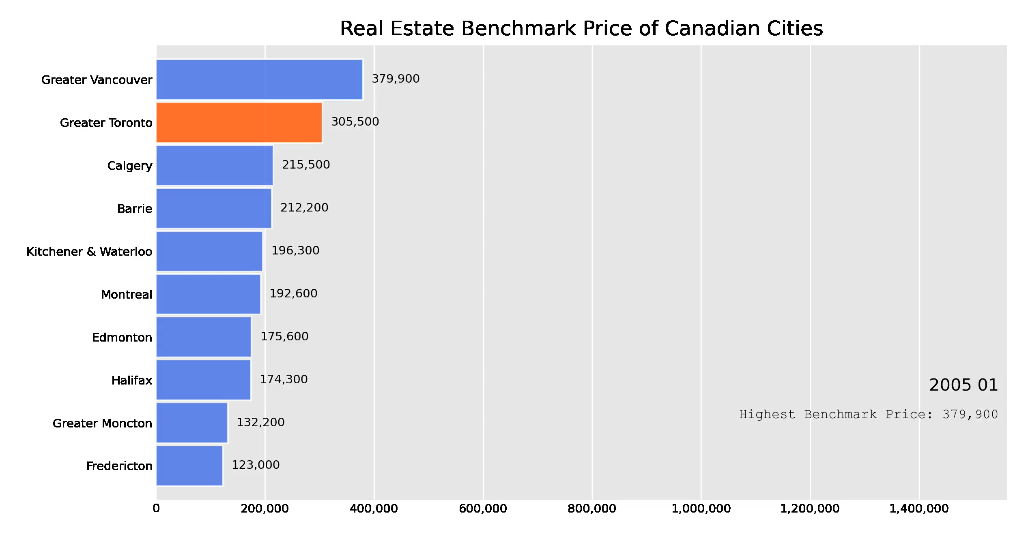
GREEDY OR CRAZY

Slide 6

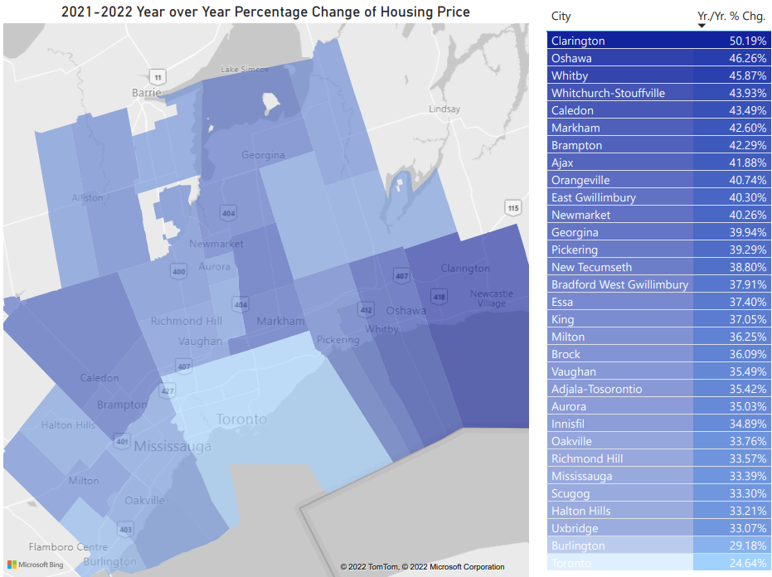
REALITY IS CRUEL
FACT
Greater Toronto Area housing price jumped by +33.29% in 2021.

Slide 7
OUR TASK
Which factors drove the huge jump of GTA housing price?
What will the GTA housing price look like in 2022?

Slide 8
TIME SERIES
2

Slide 9

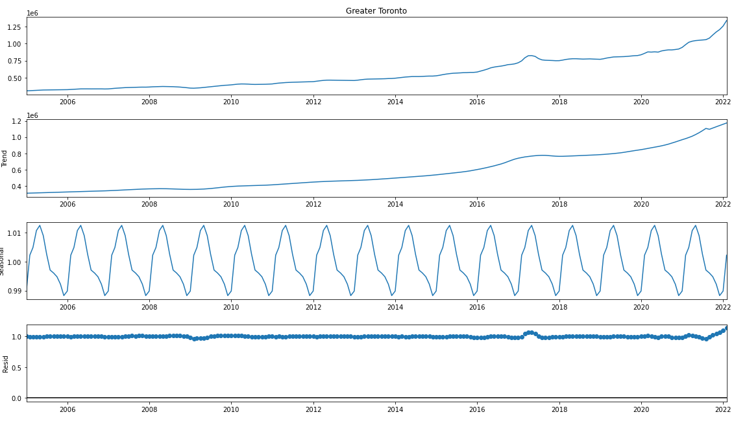
DIGGING INTO PRICE

Slide 10
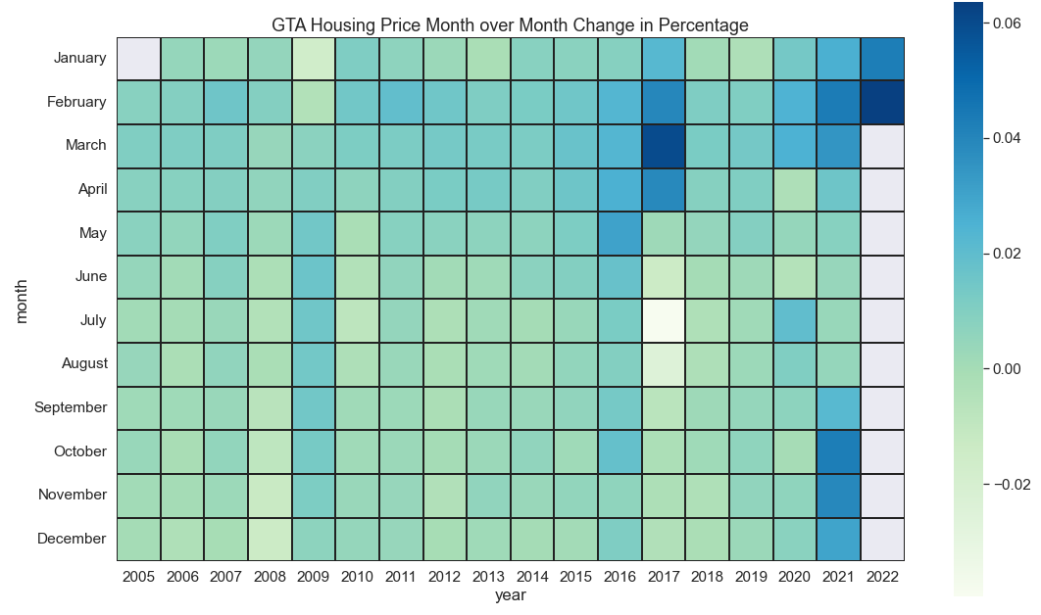
MORE SEASONAL INFLUENCE
Can you find the anomalies?

Slide 11

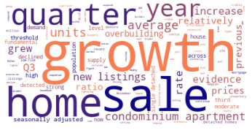
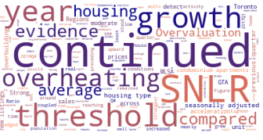
GOVERNMENT’S VOICE
2017 CMHC Assessment
2020 CMHC Assessment

Slide 12
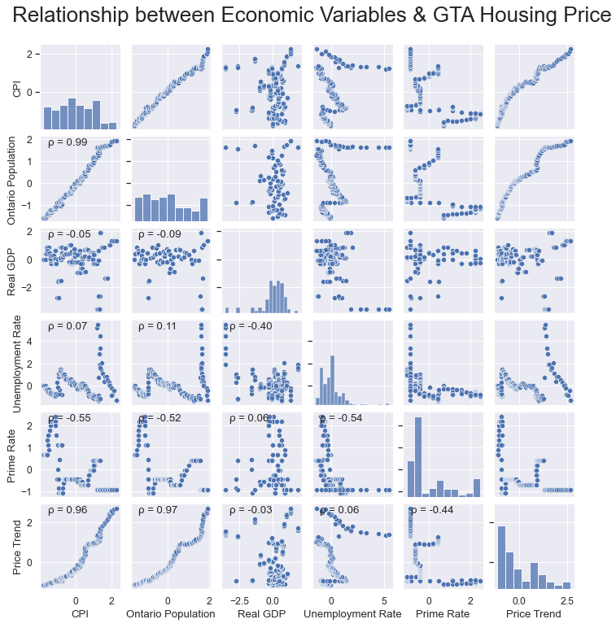
SOME ECONOMIC FEATURES WE CAN LEVERAGE

Slide 13
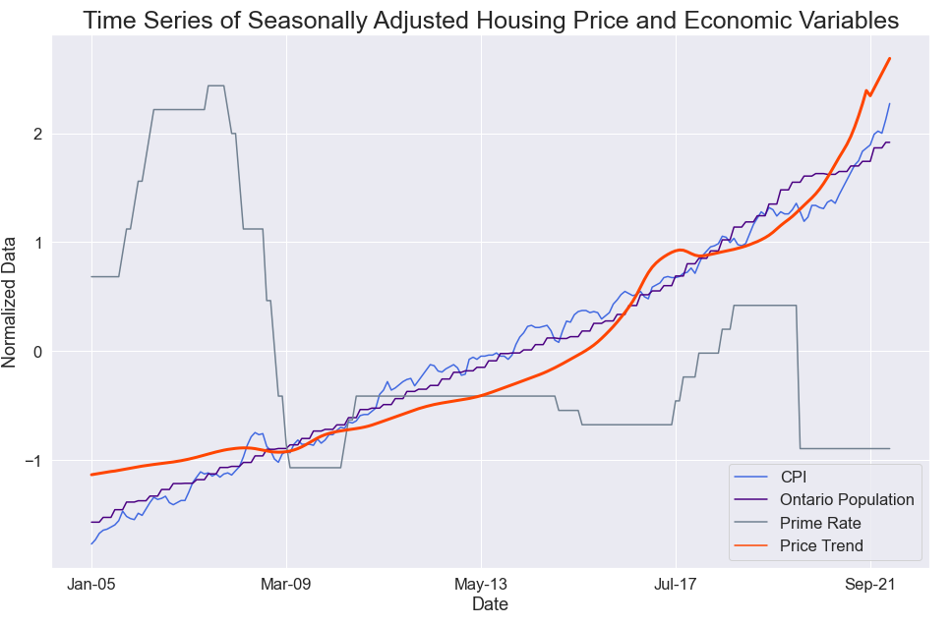
INCORPORATE THE TIME
Population & CPI
Highly correlated through whole periods
Prime Rate
Correlated after 2009;
Lagged impact to price

Slide 14

FORECAST THE FUTURE
3

Slide 15
A HYBRID APPROACH
SEASONALITY
TREND
Recurrent Neural Network
Gated Recurrent Unit(GRU):
12 steps look-back period
12 steps forecasting
1 hidden layers with 24 hidden units
Activation Function ReLU
Train at 35 epochs
Ridge Regression
Ontario Population
CPI
Prime Rate

Slide 16
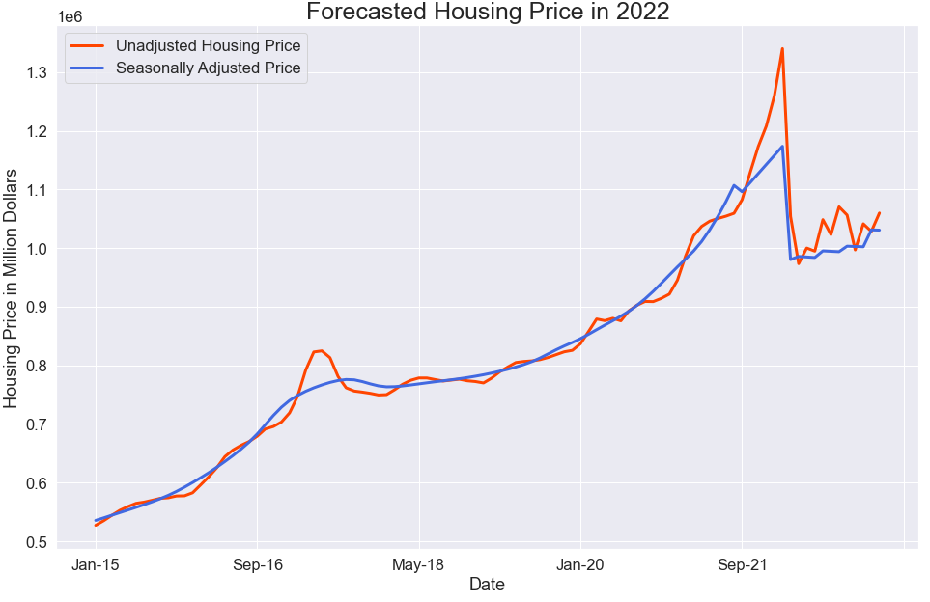
FORECASTING RESULT
Interesting Findings
March 2022 Housing Price forecasted by regression is extremely away from starting points, which indicates outliers/anomalies in 2021-2022.

Slide 17

CONCLUSION
4

Slide 18

FACTORS
$1,340,000
$1,028,790
Seasonality, Government’s Policy, Population, Inflation, Prime Rates
Current benchmark price in Greater Toronto Area
Forecasted average price in 2022 based on Population, Prime Rate and CPI and Seasonality

Slide 19
REFERENCES
Statistics Canada. (2022). Table 36-10-0112-01 Current and capital accounts - Households, Canada, quarterly https://doi.org/10.25318/3610011201-eng
Statistics Canada. (2022). Table 18-10-0004-01 Consumer Price Index, monthly, not seasonally adjusted https://doi.org/10.25318/1810000401-eng
Statistics Canada. (2022). Table 17-10-0009-01 Population estimates, quarterly, https://doi.org/10.25318/1710000901-eng
Statistics Canada. (2022). Table 14-10-0287-01 Labour force characteristics, monthly, seasonally adjusted and trend-cycle, last 5 months, https://doi.org/10.25318/1410028701-eng
Craig Wright, Dawn Desjardins and Nathan Janzen (2022), Russian invasion and surging inflation take over as key global growth risks, RBC Economics, https://royal-bank-of-canada-2124.docs.contently.com/v/macro-2022
Canada Mortgage and Housing Corporation. (2020) HOUSING MARKET ASSESSMENT Greater Toronto Area https://www.cmhc-schl.gc.ca/chic/Listing?item_ID={982E3CCA-B878-4486-A021-4FB6903C4BA8}
The Canadian Real Estate Association (2022), MLS® Home Price Index (HPI), https://www.crea.ca/housing-market-stats/mls-home-price-index/hpi-tool/
Toronto Regional Real Estate Board, Market Watch February 2022, https://trreb.ca/files/market-stats/market-watch/mw2202.pdf

Slide 20
THANKS
Any questions?
shijie.li@ryerson.ca
https://www.linkedin.com/in/daniel-li-cfa-96620a121/

